Slide 1


Slide 2



Advanced Programming Applications
Lecture 05- JavaFX – Part II
Dr. Mohamed Mostafa Eltaweel

Slide 3
Lecture Outline
Inner Classes
Anonymous Inner Classes
Lambda Expression
JavaFX - Event Handling
JavaFX – Animations
JavaFX and CSS
Practice

Slide 4

Inner Classes
Inner class: A class is a member of another class.
Advantages: In some applications, you can use an inner
class to make programs simple.
An inner class can reference the data and methods defined in the outer class in which it nests, so you do not need to pass the reference of the outer class to the constructor of the inner class
public class Car {// The Outer Class
public class Engine {// THIS IS THE INNER CLASS
} // END OF THE INNER CLASS
}

Slide 5
public class Car {// The Outer Class
private String model;
private boolean isRunning;
public Car(String model) {
this.model = model;
this.isRunning = false;
}
public class Engine {// THIS IS THE INNER CLASS
public void start() {
// The Inner Class can access the Outer Class's private variables!
if (!isRunning) {
isRunning = true;
System.out.println("The " + model + "'s engine fires up. Vroom!");
}
}
} // END OF THE INNER CLASS
}

Slide 6
public class Main {
public static void main(String[] args) {
// Step 1: You MUST create an instance of the Outer Class first
Car myMustang = new Car("Ford Mustang");
// Step 2: Use the Outer Class instance to create the Inner Class
// Notice the syntax: OuterClass.InnerClass variable = outerInstance.new InnerClass();
Car.Engine mustangEngine = myMustang.new Engine();
// Step 3: Run the inner class method
mustangEngine.start(); // Output: The Ford Mustang's engine fires up. Vroom!
mustangEngine.start(); // Output: The Ford Mustang's engine is already running.
}
}

Slide 7
Inner Classes
An inner class supports the work of its containing outer class and is compiled into a class named
OuterClassName$InnerClassName.class
An inner class can be declared public, protected, or private subject to the same visibility rules applied to a member of the class.
An inner class can be declared static.
A static inner class can be accessed using the outer class name.
A static inner class cannot access nonstatic members of the outer class.
Notes:
To be perfectly precise with Java terminology, once you add the static keyword, it is technically no longer called an "inner class" but rather a "Static Nested Class." However, developers use the terms interchangeably all the time.

Slide 8
Anonymous Inner Classes
An anonymous inner class is an inner class without a name
An anonymous inner class must always extend a superclass or implement an interface, but it cannot have an explicit extends or implements clause.
An anonymous inner class must implement all the abstract methods in the superclass or in the interface.
An anonymous inner class uses the no-arg constructor from its superclass to create an instance.
An anonymous inner class is compiled into a class named OuterClassName$n.class. For example, if the outer class Test has two anonymous inner classes, these two classes are compiled into Test$1.class and Test$2.class.

Slide 9
Anonymous Inner Classes
interface MathOperation {
int calculate(int a, int b);
}
class AdditionOperation implements MathOperation {
@Override
public int calculate(int a, int b) {
int sum = a + b;
System.out.println("The sum is: " + sum);
return sum;
}
}
public class Main {
public static void main(String[] args) {
MathOperation addition = new AdditionOperation();
addition.calculate(5, 10);
}
}
The Traditional Way:
A Named Class

Slide 10
Anonymous Inner Classes
interface MathOperation {
int calculate(int a, int b);
}
class AdditionOperation{
public class Main {
public static void main(String[] args) {
MathOperation addition = new MathOperation() {
@Override
public int calculate(int a, int b) {
int sum = a + b;
System.out.println("The sum is: " + sum);
return sum; }
};
addition.calculate(5, 10);
}
}
The Modren Way:
Anonymous Inner Class

Slide 11
Lambda Expressions
Lambda expression is a new feature in Java 8.
Lambda expressions can be viewed as an
Lambda expression facilitates functional programming.
A Lambda expression is a short block of code that takes in parameters and returns a value.
It is essentially an anonymous function—a method that doesn't need a name, an access modifier (like public or private), or a return type declaration.
parameter -> expression
(parameter1, parameter2) -> expression
Notes:
A lambda expression consists of three main parts:
Parameters ( ): A comma-separated list of formal parameters enclosed in parentheses. If there is only one parameter, the parentheses can be omitted. If there are no parameters, empty parentheses are required.
The Arrow Token ->: This simply links the parameters to the body of the lambda. You can read it as "becomes" or "goes to".
The Body { }: Contains expressions or statements. If it's a single expression, curly braces are not required, and the result of the expression is automatically returned. If it contains multiple statements, curly braces are required, and you must explicitly use a return statement if a value needs to be returned.

Slide 12
Lambda Expressions
The Secret Sauce: Functional Interfaces
You can't just put a lambda expression anywhere. They can only be used in contexts where a Functional Interface is expected.
parameter -> expression
(parameter1, parameter2) -> expression
Check the rest of expressions at https://www.w3schools.com/java/java_lambda.asp
Notes:
A Functional Interface is simply any interface in Java that contains exactly one abstract method.
EventHandler<T> is a functional interface because it only has handle().
Runnable is a functional interface because it only has run().
ActionListener is a functional interface because it only has actionPerformed().

Slide 13
Lambda Expressions
Button btn = new Button("Submit");
btn.setOnAction(new EventHandler<ActionEvent>() {
@Override
public void handle(ActionEvent event) {
System.out.println("Button was clicked!");
}
});
"Before"
Button btn = new Button("Submit");
btn.setOnAction(event -> System.out.println("Button was clicked!"));
"After"

Slide 14
Lambda Expressions
Write a Lambda expression for adding two integers
(a, b) -> {
int sum = a + b;
System.out.println("The sum is: " + sum);
return sum;
};

Slide 15
Lambda Expressions
Programming Exercise:
Define the Interface: Create an interface named Calculator. Use the appropriate annotation to mark it as a functional interface.
Declare the Method: Inside the interface, define a single abstract method named sum that takes two int parameters and returns an int.
Setup the Main Class: Create a Main class containing a standard public static void main(String[] args) method.
Implement with a Lambda: Inside the main method, declare a variable of type Calculator. Assign it a Lambda expression that correctly implements the sum method by adding the two integer parameters together.
Execute and Print: Call the sum method using your lambda implementation, passing in the values 15 and 25. Store the result and print it to the console.

Slide 16
Lambda Expressions
Write a Lambda expression for adding two integers
interface Calculator {
int sum(int a, int b);
}
public class CalcMain {
public static void main(String[] args) {
// Use a Lambda expression to implement the interface
// Java knows 'a' and 'b' are integers because of the interface definition
Calculator addition = (a, b) -> a + b;
// 3. Call the method and store/print the result
int result = addition.sum(15, 25);
System.out.println("The result of the sum is: " + result);
}
}

Slide 17
The Secret Sauce: Functional Interfaces
You can't just put a lambda expression anywhere. They can only be used in contexts where a Functional Interface is expected.
A Functional Interface is simply any interface in Java that contains exactly one abstract method.
EventHandler <T> is a functional interface because it only has handle().
Runnable is a functional interface because it only has run().
ActionListener is a functional interface because it only has actionPerformed().

Slide 18
JavaFX - Event Handling

Slide 19
JavaFX - Event Handling
An event occurs whenever a user interacts with application components (nodes).
Examples of Events:
Clicking a button
Moving the mouse
Typing using the keyboard
Selecting an item from a list
Scrolling a page

Slide 20
Main Types of Events
1. Foreground Events
Require direct user interaction.
Generated when users interact with GUI elements.
Examples:
Button click
Mouse movement
Keyboard input
Selecting items from lists
Scrolling
2. Background Events
Do not require user interaction.
Triggered by the system or application processes.
Examples:
Operating system interruptions
Hardware or software failures
Timer expiration
Completion of an operation
The class named Event of the package javafx.event is the base class for an event.

Slide 21
Event Handling in JavaFX
Event handling is the mechanism that controls events and determines what action should occur when an event happens.
Event Handler:
The code that executes when an event occurs.
It defines the response of the application to user actions.

Slide 22
Key Components of a JavaFX Event
1. Target
The node where the event occurs.
Examples: Window, Scene, or Node (such as Button, TextField, etc.)
2. Source
The object that generates the event.
Example: Mouse or Keyboard generating the event.
3. Type
The specific category of the event.
Example for mouse events:
Mouse Pressed
Mouse Released
Mouse Clicked

Slide 23
Example: Button as the Target
public class TargetExample extends Application {
@Override
public void start(Stage stage) {
Button btn = new Button("Click Me");
btn.setOnMouseClicked(e -> { System.out.println("Target: " + e.getTarget()); System.out.println("Source: " + e.getSource()); System.out.println("Event Type: " + e.getEventType()); });
Scene scene = new Scene(btn, 300, 200);
stage.setScene(scene);
stage.setTitle("Target Example");
stage.show();
}
public static void main(String[] args) {
launch(); } }
Target
Type: Mouse Clicked
Source
Outputs:
Target: Button
Source: Button
Event Type: MOUSE_CLICKED
Notes:
The Button is the Target.
The event happens when the user clicks the button.
The source is the object that generated the event.

Slide 24
Examples of JavaFX EventHandler
User Action | Event Type | EventHandler Properties
Pressing, releasing, or typing a key on keyboard. | KeyEvent | onKeypressed onKeyReleased onKeyTyped
Moving, Clicking, or dragging the mouse. | MouseEvent | onMouseClicked onMouseMoved onMousePressed onMouseReleased onMouseEntered onMouseExited
Pressing, Dragging, and Releasing of the mouse button. | MouseDragEvent | onMouseDragged onMouseDragEntered onMouseDragExited onMouseDragged onMouseDragOver onMouseDragReleased
Generating, Changing, Removing or Committing input from an alternate method. | InputMethodEvent | onInputMethodTextChanged
Performing Drag and Drop actions supported by the platform. | DragEvent | onDragDetected onDragDone onDragDropped onDragEntered onDragExited onDragOver
Scrolling an object. | ScrollEvent | onScroll onScrollStarted onScrollFinished
Zooming on an object. | ZoomEvent | onZoom onZoomStarted onZoomFinished
Source:
TutorialsPoints

Slide 25
Example
playButton.setOnMouseClicked((new EventHandler<MouseEvent>() {
public void handle(MouseEvent event) {
System.out.println("Hello World"); pathTransition.play();
}
}));

Slide 26
JavaFX - Animations
In JavaFX, a node can be animated by changing its property over time. JavaFX provides a package named javafx.animation
Applied animations (transitions) such as −
Fade Transition
Fill Transition
Rotate Transition
Scale Transition
Stroke Transition
Translate Transition
Path Transition
Sequential Transition
Pause Transition
Parallel Transition

Slide 27
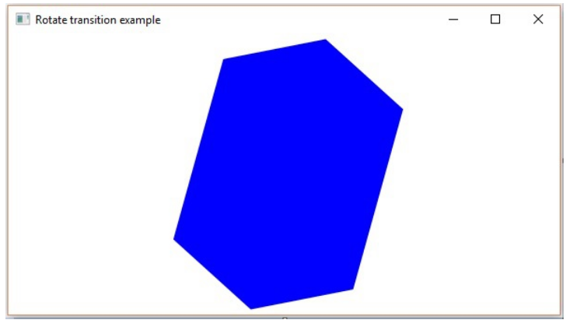
Rotate Transition in JavaFX
public class RotateTransitionExample extends Application {
@Override
public void start(Stage stage) {
//Creating a hexagon
Polygon hexagon = new Polygon();
//Adding coordinates to the hexagon
hexagon.getPoints().addAll(new Double[]{
200.0, 50.0,
400.0, 50.0,
450.0, 150.0,
400.0, 250.0,
200.0, 250.0,
150.0, 150.0,
});
//Setting the fill color for the hexagon
hexagon.setFill(Color.BLUE);
Source:
TutorialsPoints
Notes:
Rotate Transition in JavaFX is applied using the RotateTransition class in the javafx.animation package. This is done by specifying the starting value, the ending value and the duration of the transition. The RotateTransition class has the following properties −
import javafx.animation.RotateTransition;
import javafx.application.Application;
import static javafx.application.Application.launch;
import javafx.scene.Group;
import javafx.scene.Scene;
import javafx.scene.paint.Color;
import javafx.scene.shape.Polygon;
import javafx.stage.Stage;
import javafx.util.Duration;
public class RotateTransitionExample extends Application {
@Override
public void start(Stage stage) {
//Creating a hexagon
Polygon hexagon = new Polygon();
//Adding coordinates to the hexagon
hexagon.getPoints().addAll(new Double[]{
200.0, 50.0,
400.0, 50.0,
450.0, 150.0,
400.0, 250.0,
200.0, 250.0,
150.0, 150.0,
});
//Setting the fill color for the hexagon
hexagon.setFill(Color.BLUE);
//Creating a rotate transition
RotateTransition rotateTransition = new RotateTransition();
//Setting the duration for the transition
rotateTransition.setDuration(Duration.millis(1000));
//Setting the node for the transition
rotateTransition.setNode(hexagon);
//Setting the angle of the rotation
rotateTransition.setByAngle(360);
//Setting the cycle count for the transition
rotateTransition.setCycleCount(50);
//Setting auto reverse value to false
rotateTransition.setAutoReverse(false);
//Playing the animation
rotateTransition.play();
//Creating a Group object
Group root = new Group(hexagon);
//Creating a scene object
Scene scene = new Scene(root, 600, 300);
//Setting title to the Stage
stage.setTitle("Rotate transition example ");
//Adding scene to the stage
stage.setScene(scene);
//Displaying the contents of the stage
stage.show();
}
public static void main(String args[]){
launch(args);
}
}

Slide 28
Rotate Transition in JavaFX
//Creating a rotate transition
RotateTransition rotateTransition = new RotateTransition();
//Setting the duration for the transition
rotateTransition.setDuration(Duration.millis(1000));
//Setting the node for the transition
rotateTransition.setNode(hexagon);
//Setting the angle of the rotation
rotateTransition.setByAngle(360);
//Setting the cycle count for the transition
rotateTransition.setCycleCount(50);
//Setting auto reverse value to false
rotateTransition.setAutoReverse(false);
//Playing the animation
rotateTransition.play();
//Creating a Group object
Group root = new Group(hexagon);
//Creating a scene object
Scene scene = new Scene(root, 600, 300);
//Setting title to the Stage
stage.setTitle("Rotate transition example ");
//Adding scene to the stage
stage.setScene(scene);
//Displaying the contents of the stage
stage.show();
}
Source:
TutorialsPoints
Notes:
Rotate Transition in JavaFX is applied using the RotateTransition class in the javafx.animation package. This is done by specifying the starting value, the ending value and the duration of the transition. The RotateTransition class has the following properties −

Slide 29
Rotate Transition in JavaFX
//Playing the animation
rotateTransition.play();
//Creating a Group object
Group root = new Group(hexagon);
//Creating a scene object
Scene scene = new Scene(root, 600, 300);
//Setting title to the Stage
stage.setTitle("Rotate transition example ");
//Adding scene to the stage
stage.setScene(scene);
//Displaying the contents of the stage
stage.show();
}
Source:
TutorialsPoints
Notes:
Rotate Transition in JavaFX is applied using the RotateTransition class in the javafx.animation package. This is done by specifying the starting value, the ending value and the duration of the transition. The RotateTransition class has the following properties −

Slide 30
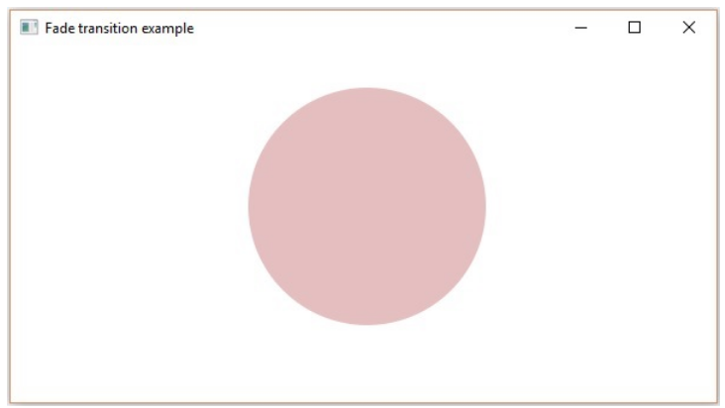
JavaFX - Fade Transition
import javafx.animation.FadeTransition;
import javafx.application.Application;
import javafx.scene.Group;
import javafx.scene.Scene;
import javafx.scene.paint.Color;
import javafx.scene.shape.Circle;
import javafx.stage.Stage;
import javafx.util.Duration;
public class FadeTransitionExample extends Application {
@Override
public void start(Stage stage) {
//Drawing a Circle
Circle circle = new Circle();
//Setting the position of the circle
circle.setCenterX(300.0f);
circle.setCenterY(135.0f);
Source:
TutorialsPoints
Notes:
import javafx.animation.FadeTransition;
import javafx.application.Application;
import javafx.scene.Group;
import javafx.scene.Scene;
import javafx.scene.paint.Color;
import javafx.scene.shape.Circle;
import javafx.stage.Stage;
import javafx.util.Duration;
public class FadeTransitionExample extends Application {
@Override
public void start(Stage stage) {
//Drawing a Circle
Circle circle = new Circle();
//Setting the position of the circle
circle.setCenterX(300.0f);
circle.setCenterY(135.0f);
//Setting the radius of the circle
circle.setRadius(100.0f);
//Setting the color of the circle
circle.setFill(Color.BROWN);
//Setting the stroke width of the circle
circle.setStrokeWidth(20);
//Creating the fade Transition
FadeTransition fadeTransition = new FadeTransition(Duration.millis(1000));
//Setting the node for Transition
fadeTransition.setNode(circle);
//Setting the property fromValue of the transition (opacity)
fadeTransition.setFromValue(1.0);
//Setting the property toValue of the transition (opacity)
fadeTransition.setToValue(0.3);
//Setting the cycle count for the transition
fadeTransition.setCycleCount(50);
//Setting auto reverse value to false
fadeTransition.setAutoReverse(false);
//Playing the animation
fadeTransition.play();
//Creating a Group object
Group root = new Group(circle);
//Creating a scene object
Scene scene = new Scene(root, 600, 300);
//Setting title to the Stage
stage.setTitle("Fade transition example");
//Adding scene to the stage
stage.setScene(scene);
//Displaying the contents of the stage
stage.show();
}
public static void main(String args[]){
launch(args);
}
}

Slide 31
JavaFX - Fade Transition
//Setting the radius of the circle
circle.setRadius(100.0f);
//Setting the color of the circle
circle.setFill(Color.BROWN);
//Setting the stroke width of the circle
circle.setStrokeWidth(20);
//Creating the fade Transition
FadeTransition fadeTransition = new FadeTransition(Duration.millis(1000));
//Setting the node for Transition
fadeTransition.setNode(circle);
//Setting the property fromValue of the transition (opacity)
fadeTransition.setFromValue(1.0);
Source:
TutorialsPoints
Notes:
import javafx.animation.FadeTransition;
import javafx.application.Application;
import javafx.scene.Group;
import javafx.scene.Scene;
import javafx.scene.paint.Color;
import javafx.scene.shape.Circle;
import javafx.stage.Stage;
import javafx.util.Duration;
public class FadeTransitionExample extends Application {
@Override
public void start(Stage stage) {
//Drawing a Circle
Circle circle = new Circle();
//Setting the position of the circle
circle.setCenterX(300.0f);
circle.setCenterY(135.0f);
//Setting the radius of the circle
circle.setRadius(100.0f);
//Setting the color of the circle
circle.setFill(Color.BROWN);
//Setting the stroke width of the circle
circle.setStrokeWidth(20);
//Creating the fade Transition
FadeTransition fadeTransition = new FadeTransition(Duration.millis(1000));
//Setting the node for Transition
fadeTransition.setNode(circle);
//Setting the property fromValue of the transition (opacity)
fadeTransition.setFromValue(1.0);
//Setting the property toValue of the transition (opacity)
fadeTransition.setToValue(0.3);
//Setting the cycle count for the transition
fadeTransition.setCycleCount(50);
//Setting auto reverse value to false
fadeTransition.setAutoReverse(false);
//Playing the animation
fadeTransition.play();
//Creating a Group object
Group root = new Group(circle);
//Creating a scene object
Scene scene = new Scene(root, 600, 300);
//Setting title to the Stage
stage.setTitle("Fade transition example");
//Adding scene to the stage
stage.setScene(scene);
//Displaying the contents of the stage
stage.show();
}
public static void main(String args[]){
launch(args);
}
}

Slide 32
JavaFX - Fade Transition
//Setting the property toValue of the transition (opacity)
fadeTransition.setToValue(0.3);
//Setting the cycle count for the transition
fadeTransition.setCycleCount(50);
//Setting auto reverse value to false
fadeTransition.setAutoReverse(false);
//Playing the animation
fadeTransition.play();
//Creating a Group object
Group root = new Group(circle);
//Creating a scene object
Scene scene = new Scene(root, 600, 300);
//Setting title to the Stage
stage.setTitle("Fade transition example");
//Adding scene to the stage
stage.setScene(scene);
//Displaying the contents of the stage
stage.show();
}
public static void main(String args[]){
launch(args);
}
}
Source:
TutorialsPoints
Notes:
import javafx.animation.FadeTransition;
import javafx.application.Application;
import javafx.scene.Group;
import javafx.scene.Scene;
import javafx.scene.paint.Color;
import javafx.scene.shape.Circle;
import javafx.stage.Stage;
import javafx.util.Duration;
public class FadeTransitionExample extends Application {
@Override
public void start(Stage stage) {
//Drawing a Circle
Circle circle = new Circle();
//Setting the position of the circle
circle.setCenterX(300.0f);
circle.setCenterY(135.0f);
//Setting the radius of the circle
circle.setRadius(100.0f);
//Setting the color of the circle
circle.setFill(Color.BROWN);
//Setting the stroke width of the circle
circle.setStrokeWidth(20);
//Creating the fade Transition
FadeTransition fadeTransition = new FadeTransition(Duration.millis(1000));
//Setting the node for Transition
fadeTransition.setNode(circle);
//Setting the property fromValue of the transition (opacity)
fadeTransition.setFromValue(1.0);
//Setting the property toValue of the transition (opacity)
fadeTransition.setToValue(0.3);
//Setting the cycle count for the transition
fadeTransition.setCycleCount(50);
//Setting auto reverse value to false
fadeTransition.setAutoReverse(false);
//Playing the animation
fadeTransition.play();
//Creating a Group object
Group root = new Group(circle);
//Creating a scene object
Scene scene = new Scene(root, 600, 300);
//Setting title to the Stage
stage.setTitle("Fade transition example");
//Adding scene to the stage
stage.setScene(scene);
//Displaying the contents of the stage
stage.show();
}
public static void main(String args[]){
launch(args);
}
}

Slide 33
JavaFX - Fade Transition
//Setting title to the Stage
stage.setTitle("Fade transition example");
//Adding scene to the stage
stage.setScene(scene);
//Displaying the contents of the stage
stage.show();
}
public static void main(String args[]){
launch(args);
}
}
Source:
TutorialsPoints
Notes:
import javafx.animation.FadeTransition;
import javafx.application.Application;
import javafx.scene.Group;
import javafx.scene.Scene;
import javafx.scene.paint.Color;
import javafx.scene.shape.Circle;
import javafx.stage.Stage;
import javafx.util.Duration;
public class FadeTransitionExample extends Application {
@Override
public void start(Stage stage) {
//Drawing a Circle
Circle circle = new Circle();
//Setting the position of the circle
circle.setCenterX(300.0f);
circle.setCenterY(135.0f);
//Setting the radius of the circle
circle.setRadius(100.0f);
//Setting the color of the circle
circle.setFill(Color.BROWN);
//Setting the stroke width of the circle
circle.setStrokeWidth(20);
//Creating the fade Transition
FadeTransition fadeTransition = new FadeTransition(Duration.millis(1000));
//Setting the node for Transition
fadeTransition.setNode(circle);
//Setting the property fromValue of the transition (opacity)
fadeTransition.setFromValue(1.0);
//Setting the property toValue of the transition (opacity)
fadeTransition.setToValue(0.3);
//Setting the cycle count for the transition
fadeTransition.setCycleCount(50);
//Setting auto reverse value to false
fadeTransition.setAutoReverse(false);
//Playing the animation
fadeTransition.play();
//Creating a Group object
Group root = new Group(circle);
//Creating a scene object
Scene scene = new Scene(root, 600, 300);
//Setting title to the Stage
stage.setTitle("Fade transition example");
//Adding scene to the stage
stage.setScene(scene);
//Displaying the contents of the stage
stage.show();
}
public static void main(String args[]){
launch(args);
}
}

Slide 34
JavaFX and CSS
we can add our own style sheet to a scene in JavaFX using the getStylesheets() method as shown below
we can also add in-line styles using the setStyle() method.
Scene scene = new Scene(new Group(), 500, 400); scene.getStylesheets().add("path/stylesheet.css");
text1.setStyle("-fx-font: normal bold 20px 'serif' "); text2.setStyle("-fx-font: normal bold 20px 'serif' ");
Notes:
import javafx.application.Application;
import static javafx.application.Application.launch;
import javafx.geometry.Insets;
import javafx.geometry.Pos;
import javafx.scene.Scene;
import javafx.scene.control.Button;
import javafx.scene.control.PasswordField;
import javafx.scene.layout.GridPane;
import javafx.scene.text.Text;
import javafx.scene.control.TextField;
import javafx.stage.Stage;
public class CssExample extends Application {
@Override
public void start(Stage stage) {
//creating label email
Text text1 = new Text("Email");
//creating label password
Text text2 = new Text("Password");
//Creating Text Filed for email
TextField textField1 = new TextField();
//Creating Text Filed for password
PasswordField textField2 = new PasswordField();
//Creating Buttons
Button button1 = new Button("Submit");
Button button2 = new Button("Clear");
//Creating a Grid Pane
GridPane gridPane = new GridPane();
//Setting size for the pane
gridPane.setMinSize(400, 200);
//Setting the padding
gridPane.setPadding(new Insets(10, 10, 10, 10));
//Setting the vertical and horizontal gaps between the columns
gridPane.setVgap(5);
gridPane.setHgap(5);
//Setting the Grid alignment
gridPane.setAlignment(Pos.CENTER);
//Arranging all the nodes in the grid
gridPane.add(text1, 0, 0);
gridPane.add(textField1, 1, 0);
gridPane.add(text2, 0, 1);
gridPane.add(textField2, 1, 1);
gridPane.add(button1, 0, 2);
gridPane.add(button2, 1, 2);
//Styling nodes
button1.setStyle("-fx-background-color: darkslateblue; -fx-text-fill: white;");
button2.setStyle("-fx-background-color: darkslateblue; -fx-text-fill: white;");
text1.setStyle("-fx-font: normal bold 20px 'serif' ");
text2.setStyle("-fx-font: normal bold 20px 'serif' ");
gridPane.setStyle("-fx-background-color: BEIGE;");
// Creating a scene object
Scene scene = new Scene(gridPane, 400, 300);
// Setting title to the Stage
stage.setTitle("CSS Example in JavaFX");
// Adding scene to the stage
stage.setScene(scene);
//Displaying the contents of the stage
stage.show();
}
public static void main(String args[]){
launch(args);
}
}

Slide 35
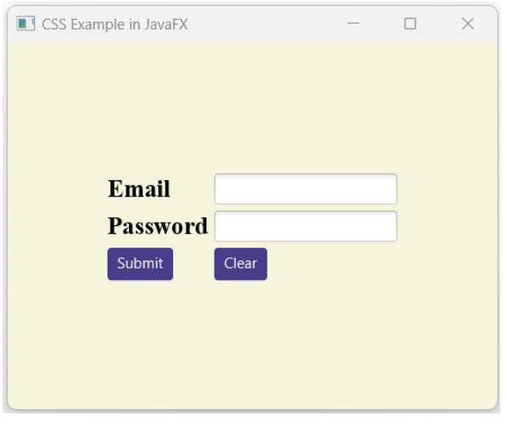
Assignment
Use JavaFx to generates a fully functional window as shown below.
The password and user name are stored in text file

Slide 36

Thank you

